Slide 1
Theology and praxis of fresh expressions of church Theologie und Praxis von Fresh-X

Slide 2
What are fresh expressions of church?
Was sind Fresh-X
Missional
Contextual
Formational
Ecclesial
Missional
Kontextuell
Lebensverändernd
Gemeindebildend

Slide 3
How do fresh expressions come to birth? Wie entstehen Fresh-X?
Liebende,
dienende
Aktivität
Jesus
kennenlernen
und folgen
Gemeinde-
bildung
von vorne
beginnen
Hörend
Gemeinschaft
Listening
loving and
serving
activity
form
community
explore
discipleship
church
takes
shape
do it
again
underpinned by prayer, ongoing listening and relationship with the wider church
Getragen von Gebet, achtsamem Hören und Gemeinschaft mit der Kirche

Slide 4
Church in life Kirche im Leben
Current model of local church:
Gather for worship
Scatter for mission
Gegenwärtiges Modell von Kirche:
Gemeinsam im Gottesdienst
Einzeln in der Mission

Slide 5
Church in life Kirche im Leben
The current model:
Gather for worship
Scatter for mission
But difficult to engage in mission alone
Aber es ist schwierig, alleine Mission zu treiben.

Slide 6
Church in life Kirche im Leben
The current model
Difficult to engage in mission alone
So God wants mission in community
Gott will Mission in Gemeinschaft

Slide 7
Church in life Kirche im Leben
The current model
Difficult to engage in mission alone
So God wants mission in community
Divine communion-in-mission
Göttliche Missions-Gemeinschaft

Slide 8
Church in life Kirche im Leben
The current model
Difficult to engage in mission alone
So God wants mission in community
Divine communion-in-mission
Creation
Schöpfung

Slide 9
Church in life Kirche im Leben
The current model
Difficult to engage in mission alone
So God wants mission in community
Divine communion-in-mission
Creation
Israel

Slide 10
Church in life Kirche im Leben
The current model
Difficult to engage in mission alone
So God wants mission in community
Divine communion-in-mission
Creation
Israel
Jesus & disciples
Jesus und seine Jünger

Slide 11
Church in life Kirche im Leben
The current model
Difficult to engage in mission alone
So God wants mission in community
These communities are to be in life
Gemeinschaften mitten im Leben

Slide 12
Church in life Kirche im Leben
The current model
Difficult to engage in mission alone
So God wants mission in community
These communities are to be in life
Jesus and his disciples
Jesus und seine Jünger

Slide 13
Church in life Kirche im Leben
The current model
Difficult to engage in mission alone
So God wants mission in community
These communities are to be in life
Jesus and his disciples
First Christians
Erste Christen

Slide 14
Church in life Kirche im Leben
The current model
Difficult to engage in mission alone
So God wants mission in community
These communities are to be in life
Jesus and his disciples
First Christians
Middle ages
Mittelalter

Slide 15
Church in life Kirche im Leben
The current model
Difficult to engage in mission alone
So God wants mission in community
These communities are to be in life
Jesus and his disciples
First Christians
Middle ages
It changed with the industrial revolution
Veränderungen durch die industrielle Revolution

Slide 16
Church in life Kirche im Leben
The current model
Difficult to engage in mission alone
So God wants mission in community
These communities are to be in life
Fresh expressions look back to the past
Fresh-X knüpfen an die Tradition an

Slide 17
Church in life Kirche im Leben
The current model
Difficult to engage in mission alone
So God wants mission in community
These communities are to be in life
Fresh expressions look back to the past
And they herald the future
Fresh-X knüpfen an die Tradition an
Und sie modellieren die Zukunft

Slide 18
Gathered to dispersed mission Versammelnde und aussendende Mission
Gathered mission
today
Versammelnde Mission
heute

Slide 19
Gathered to dispersed mission Versammelnde und aussendende Mission
Gathered mission
today
in Israel

Slide 20
Gathered to dispersed mission Versammelnde und aussendende Mission
Gathered mission
today
in Israel
by Jesus

Slide 21
Gathered to dispersed mission Versammelnde und aussendende Mission
Dispersed mission
Jesus died on the edge
Aussendende Mission
Jesus starb “draußen”

Slide 22
Gathered to dispersed mission
Dispersed mission
Jesus died on the edge
His community disintegrated
Seine Gemeinschaft zerbrach

Slide 23
Gathered to dispersed mission Versammelnde und aussendende Mission
Dispersed mission
Jesus died on the edge
His community disintegrated
Resurrection to his community
Auferstehung der Gemeinschaft

Slide 24
Gathered to dispersed mission Versammelnde und aussendende Mission
Dispersed mission
Jesus died on the edge
His community disintegrated
Resurrection to his community
A new going out dynamic
Eine neue Geh-Dynamik

Slide 25
Gathered to dispersed mission Versammelnde und aussendende Mission
Dispersed mission
Jesus died on the edge
His community disintegrated
Resurrection to his community
A new going out dynamic
To make him known on the edge
Um ihn an den Rändern bekannt zu machen

Slide 26
Gathered to dispersed mission Versammelnde und aussendende Mission
Dispersed mission
Jesus died on the edge
His community disintegrated
Resurrection to his community
A new going out dynamic
To make him known on the edge
Requires a dispersed church
Braucht eine aussendende Kirche

Slide 27
Gathered to dispersed mission Versammelnde und aussendende Mission
Dispersed mission
Jesus died on the edge
His community disintegrated
Resurrection to his community
A new going out dynamic
To make him known on the edge
Requires a dispersed church
Which demands a dying to live
Fordert Sterben um zu leben

Slide 28
Gathered to dispersed mission Versammelnde und aussendende Mission
Dispersed mission
Jesus died on the edge
His community disintegrated
Resurrection to his community
A new going out dynamic
To make him known on the edge
Requires a dispersed church
Which demands a dying to live
An example
Ein Beispiel

Slide 29
Gathered to dispersed mission Versammelnde und aussendende Mission
Dispersed mission
Jesus died on the edge
His community disintegrated
Resurrection to his community
A new going out dynamic
To make him known on the edge
Requires a dispersed church
Which demands a dying to live
An example
Being faithful to our foundational meal
Dem Abendmahl entsprechend leben

Slide 30
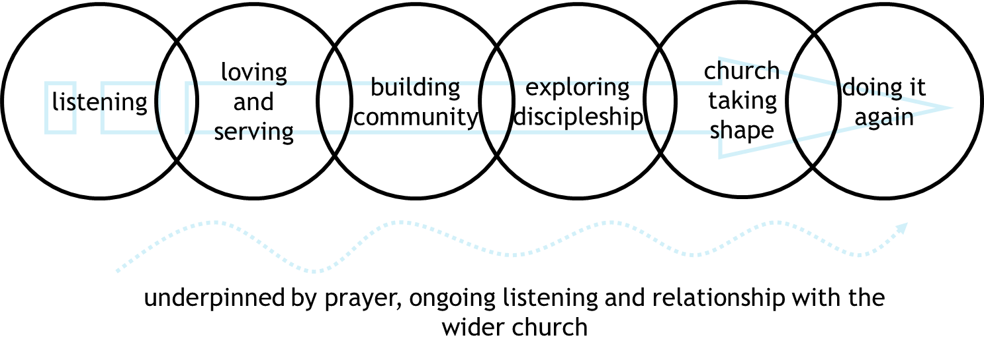
Church in life: summary
Kirche im Leben:
Zusammenfassung
The praxis of mission
Mission to be done
in community
in life
From gathered to dispersed mission
Gathered mission before the cross
Jesus died and now lives on the edge
The church disperses to reveal him on the edge
Praxis der Mission
Mission
In Gemeinschaft
Im Leben
Von einer versammelnden zu einer aussendenden Mission
versammelnd vor dem Kreuz
Jesus starb und lebt nun an den Rändern
Die Kirche sendet sich aus,
um ihn an den Rändern
erfahrbar zu machen

